Slide 1
Chapter 4
Multiple Regression Analysis: Inference

Slide 2
Multiple Regression Analysis: Inference (1 of 37)
Statistical inference in the regression model
Hypothesis tests about population parameters
Construction of confidence intervals
Sampling distributions of the OLS estimators
The OLS estimators are random variables
We already know their expected values and their variances
However, for hypothesis tests we need to know their distribution
In order to derive their distribution we need additional assumptions
Assumption about distribution of errors: normal distribution

Slide 3
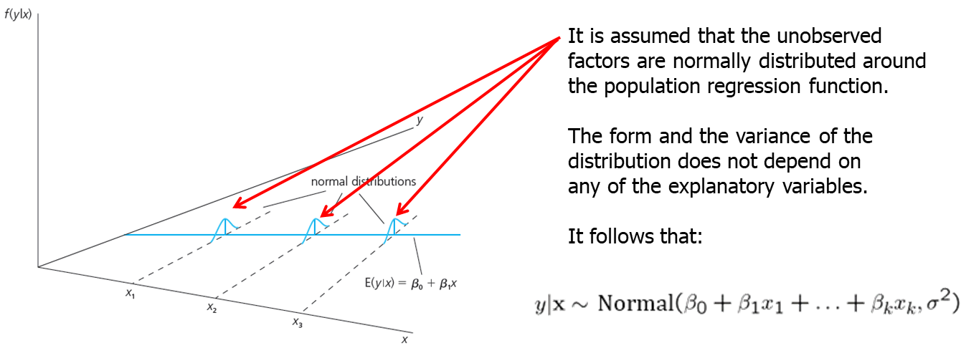
Multiple Regression Analysis: Inference (2 of 37)
Assumption MLR.6 (Normality of error terms)

Slide 4
Multiple Regression Analysis: Inference (3 of 37)
Discussion of the normality assumption
The error term is the sum of “many” different unobserved factors.
Sums of independent factors are normally distributed (CLT).
Problems:
How many different factors? Number large enough?
Possibly very heterogenuous distributions of individual factors
How independent are the different factors?
The normality of the error term is an empirical question.
At least, the error distribution should be “close” to normal.
In many cases, normality is questionable or impossible by definition.

Slide 5
Multiple Regression Analysis: Inference (4 of 37)
Discussion of the normality assumption (cont.)
Examples where normality cannot hold:
Wages (nonnegative; also: minimum wage)
Number of arrests (takes on a small number of integer values)
Unemployment (indicator variable, takes on only 1 or 0)
In some cases, normality can be achieved through transformations of the dependent variable (e.g. use log(wage) instead of wage).
Under normality, OLS is the best (even nonlinear) unbiased estimator
Important: For the purposes of statistical inference, the assumption of normality can be replaced by a large sample size.

Slide 6
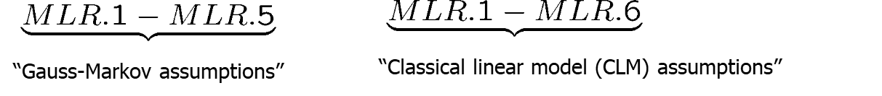
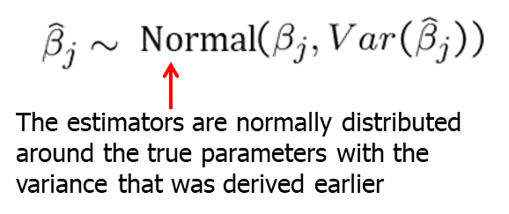
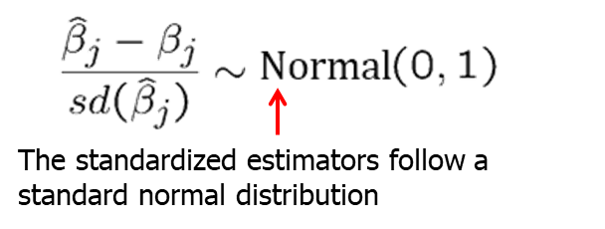
Multiple Regression Analysis: Inference (5 of 37)
Terminology
Theorem 4.1 (Normal sampling distributions)
Under assumptions MLR.1 – MLR.6:

Slide 7
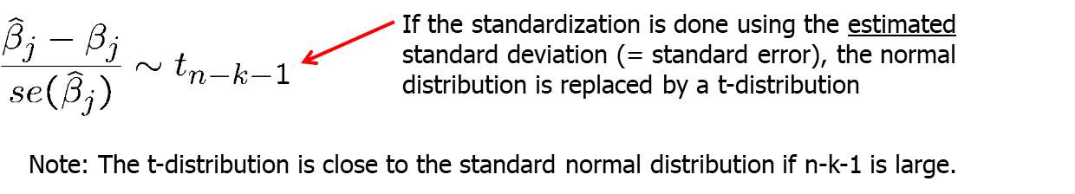
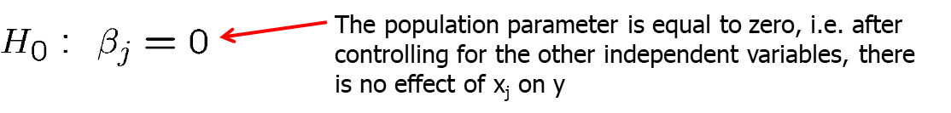
Multiple Regression Analysis: Inference (6 of 37)
Testing hypotheses about a single population parameter
Theorem 4.2 (t-distribution for the standardized estimators)
Under assumptions MLR.1 – MLR.6
Null hypothesis (for more general hypotheses, see below)

Slide 8
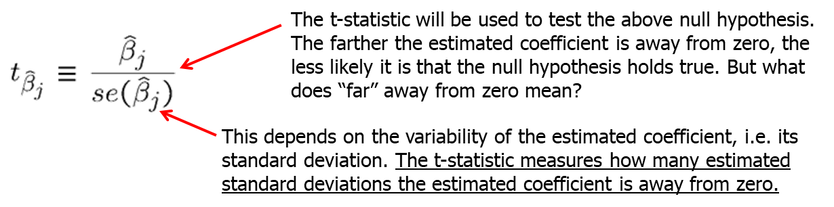
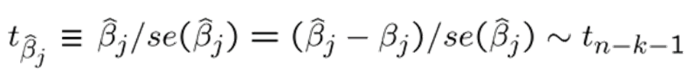
Multiple Regression Analysis: Inference (7 of 37)
t-statistic (or t-ratio)
Distribution of the t-statistic if the null hypothesis is true
Goal: Define a rejection rule so that, if it is true, H₀ is rejected only with a small probability (= significance level, e.g. 5%)

Slide 9
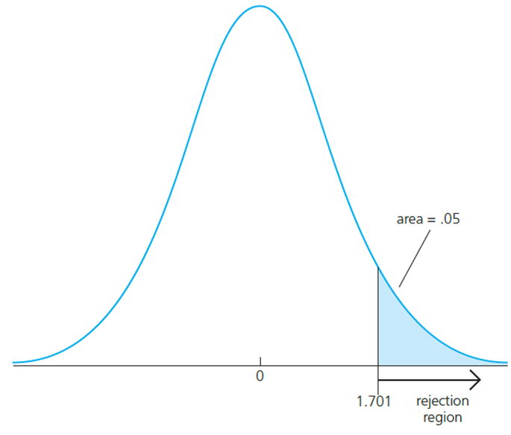
Multiple Regression Analysis: Inference (8 of 37)
Testing against one-sided alternatives (greater than zero)
Reject the null hypothesis in favour of the alternative hypothesis if the estimated coefficient is “too large” (i.e. larger than a critical value).
Construct the critical value so that, if the null hypothesis is true, it is rejected in, for example, 5% of the cases.
In the given example, this is the point of the t-distribution with 28 degrees of freedom that is exceeded in 5% of the cases.
Reject if t-statistic is greater than 1.701

Slide 10
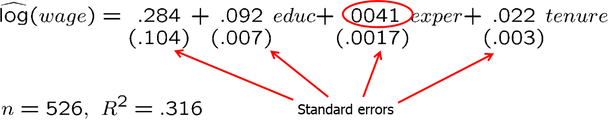
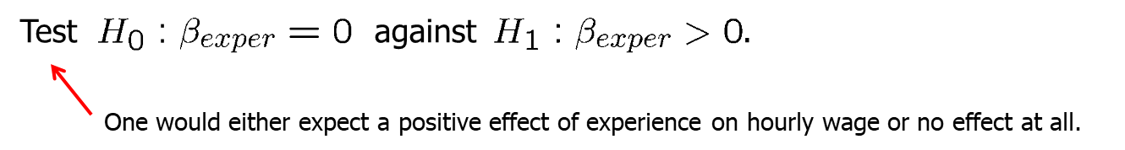
Multiple Regression Analysis: Inference (9 of 37)
Example: Wage equation
Test whether, after controlling for education and tenure, higher work experience leads to higher hourly wages.

Slide 11
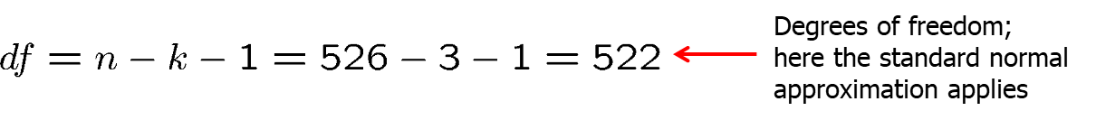
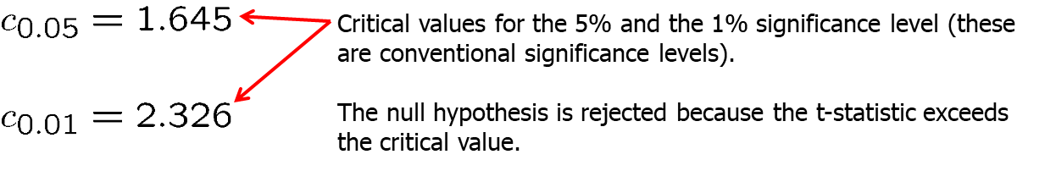
Multiple Regression Analysis: Inference (10 of 37)
Example: Wage equation (cont.)
The effect of experience on hourly wage is statistically greater than zero at the 5% (and even at the 1%) significance level.

Slide 12
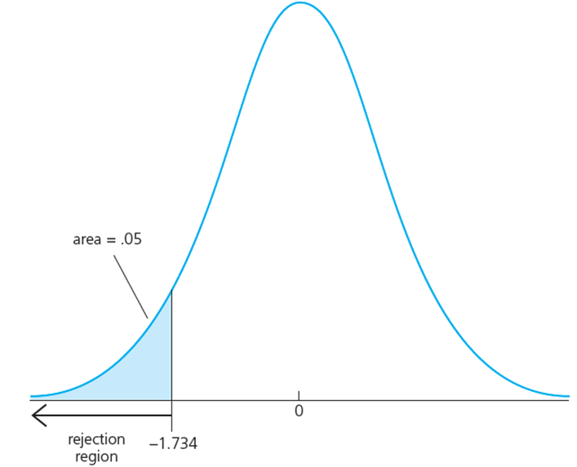
Multiple Regression Analysis: Inference (11 of 37)
Testing against one-sided alternatives (less than zero)
Reject the null hypothesis in favour of the alternative hypothesis if the estimated coefficient is “too small” (i.e. smaller than a critical value).
Construct the critical value so that, if the null hypothesis is true, it is rejected in, for example, 5% of the cases.
In the given example, this is the point of the t-distribution with 18 degrees of freedom so that 5% of the cases are below the point.
Reject if t-statistic is less than -1.734

Slide 13
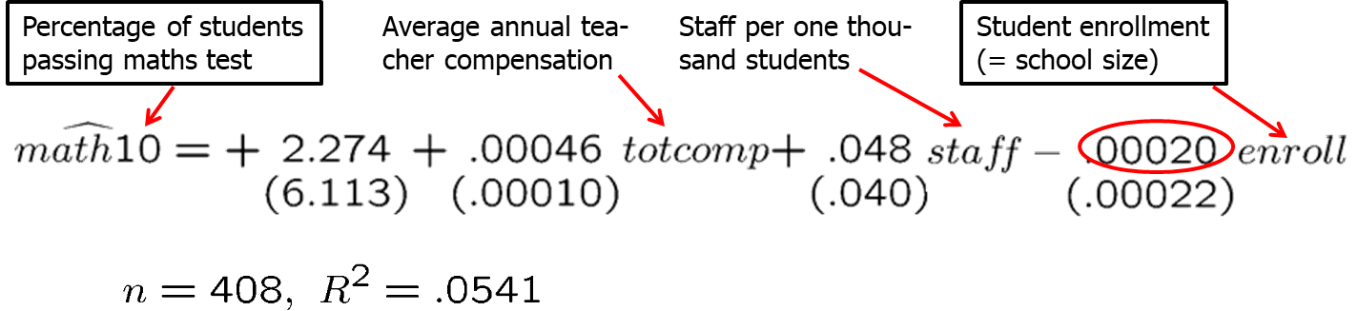
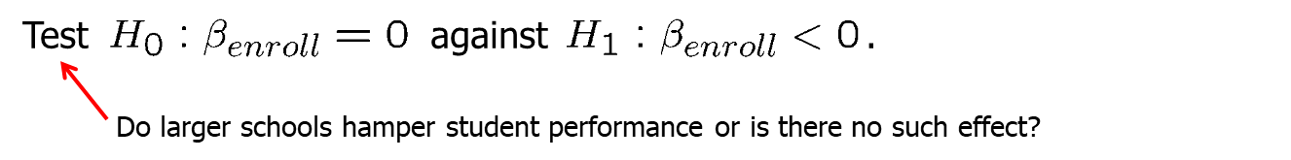
Multiple Regression Analysis: Inference (12 of 37)
Example: Student performance and school size
Test whether smaller school size leads to better student performance

Slide 14
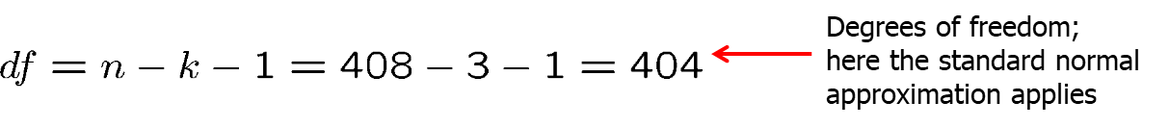
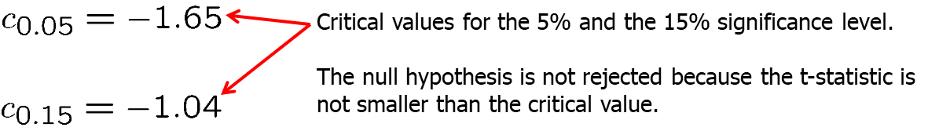
Multiple Regression Analysis: Inference (13 of 37)
Example: Student performance and school size (cont.)
One cannot reject the hypothesis that there is no effect of school size on student performance (not even for a lax significance level of 15%).

Slide 15
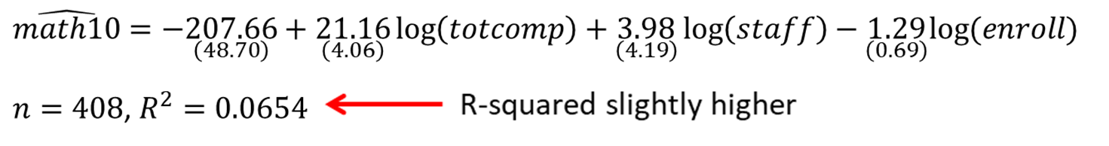
Multiple Regression Analysis: Inference (14 of 37)
Example: Student performance and school size (cont.)
Alternative specification of functional form:

Slide 16
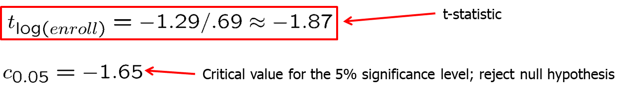
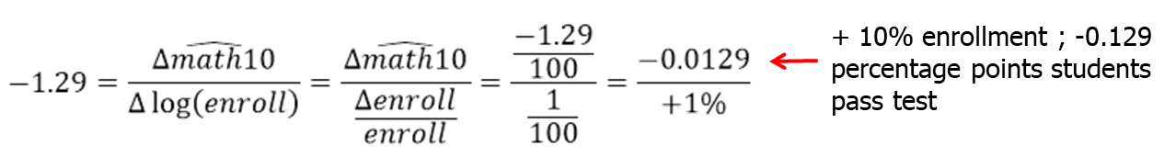
Multiple Regression Analysis: Inference (15 of 37)
Example: Student performance and school size (cont.)
The hypothesis that there is no effect of school size on student performance can be rejected in favor of the hypothesis that the effect is negative.
How large is the effect?

Slide 17
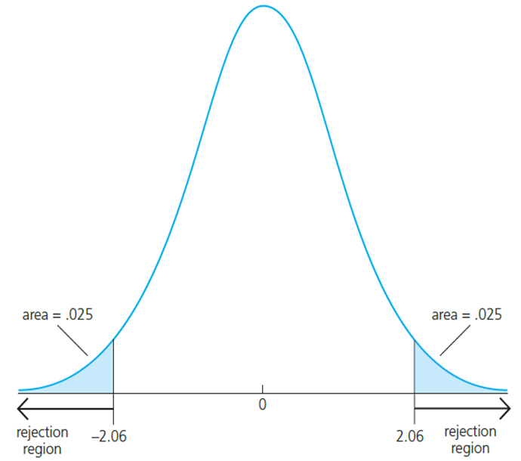
Multiple Regression Analysis: Inference (16 of 37)
Testing against two-sided alternatives
Reject the null hypothesis in favour of the alternative hypothesis if the absolute value of the estimated coefficient is too large.
Construct the critical value so that, if the null hypothesis is true, it is rejected in, for example, 5% of the cases.
In the given example, these are the points of the t-distribution so that 5% of the cases lie in the two tails.
Reject if absolute value of t-statistic is less than -2.06 or greater than 2.06

Slide 18
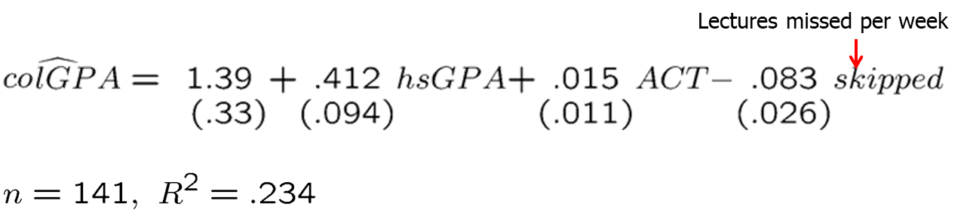
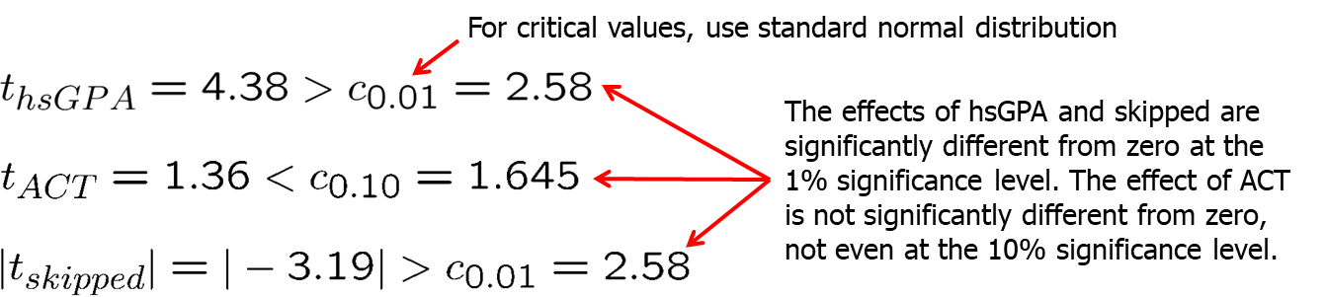
Multiple Regression Analysis: Inference (17 of 37)
Example: Determinants of college GPA

Slide 19
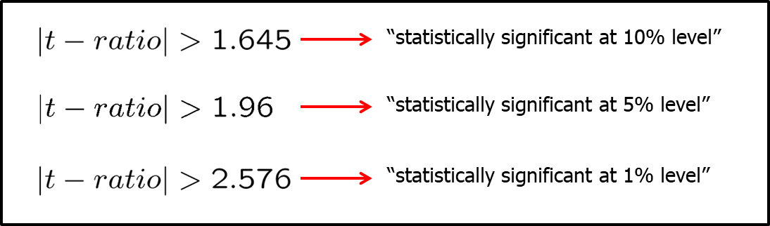
Multiple Regression Analysis: Inference (18 of 37)
“Statistically significant” variables in a regression
If a regression coefficient is different from zero in a two-sided test, the corresponding variable is said to be “statistically significant”.
If the number of degrees of freedom is large enough so that the normal approximation applies, the following rules of thumb apply:

Slide 20
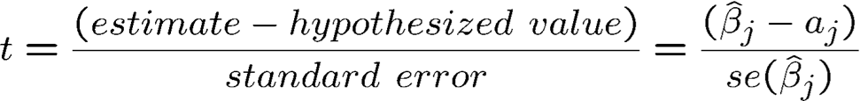
Multiple Regression Analysis: Inference (19 of 37)
Testing more general hypotheses about a regression coefficient
Null hypothesis
t-statistic
The test works exactly as before, except that the hypothesized value is substracted from the estimate when forming the statistic.

Slide 21
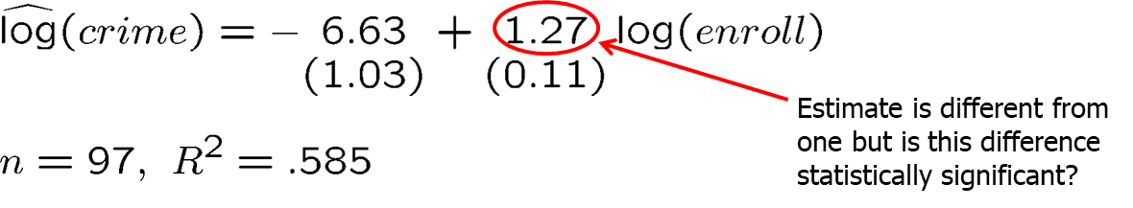
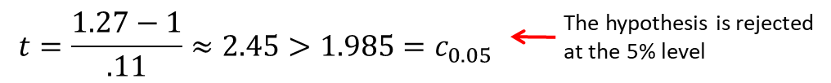
Multiple Regression Analysis: Inference (20 of 37)
Example: Campus crime and enrollment
An interesting hypothesis is whether crime increases by one percent if enrollment is increased by one percent.

Slide 22
Multiple Regression Analysis: Inference (21 of 37)
Computing p-values for t-tests
If the significance level is made smaller and smaller, there will be a point where the null hypothesis cannot be rejected anymore.
The reason is that, by lowering the significance level, one wants to avoid more and more to make the error of rejecting a correct H_{0.}
The smallest significance level at which the null hypothesis is still rejected, is called the p-value of the hypothesis test.
A small p-value is evidence against the null hypothesis because one would reject the null hypothesis even at small significance levels.
A large p-value is evidence in favor of the null hypothesis.
P-values are more informative than tests at fixed significance levels.

Slide 23
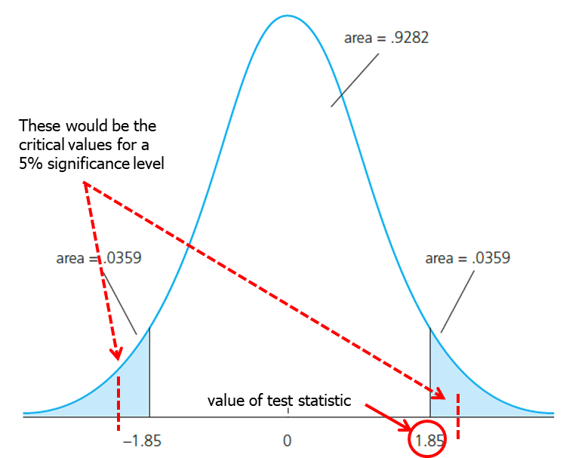
Multiple Regression Analysis: Inference (22 of 37)
How the p-value is computed (here: two-sided test)?
The p-value is the significance level at which one is indifferent between rejecting and not rejecting the null hypothesis.
In the two-sided case, the p-value is thus the probability that the t-distributed variable takes on a larger absolute value than the realized value of the test statistic, e.g.
P(|t|>1.85) = 2*(0.0359) = .0718
From this, it is clear that a null hypothesis is rejected if and only if the corresponding p-value is smaller than the significance level.
For example, for a significance level of 5% the t-statistic would not lie in the rejection region.

Slide 24
Multiple Regression Analysis: Inference (23 of 37)
Guidelines for discussing economic and statistical significance
If a variable is statistically significant, discuss the magnitude of the coefficient to get an idea of its economic or practical importance.
The fact that a coefficient is statistically significant does not necessarily mean it is economically or practically significant!
If a variable is statistically and economically important but has the “wrong” sign, the regression model might be misspecified.
If a variable is statistically insignificant at the usual levels (10%, 5%, or 1%), one may think of dropping it from the regression.
If the sample size is small, effects might be imprecisely estimated so that the case for dropping insignificant variables is less strong.

Slide 25
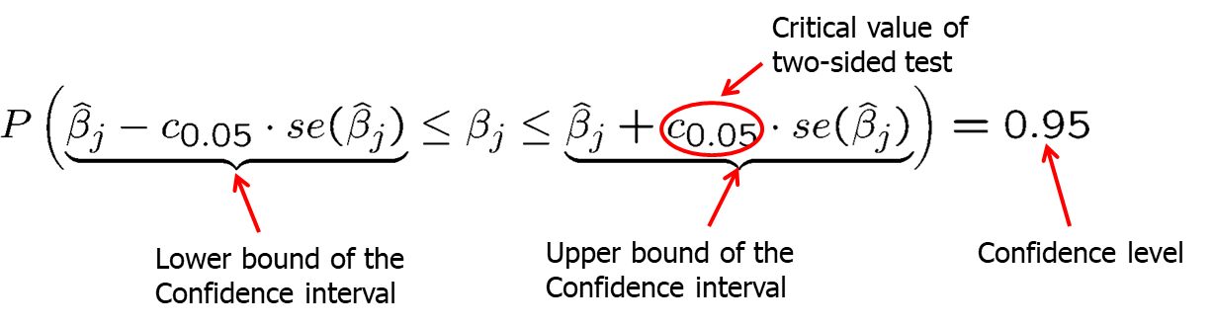
Multiple Regression Analysis: Inference (24 of 37)
Confidence intervals
Simple manipulation of the result in Theorem 4.2 implies that
Interpretation of the confidence interval
The bounds of the interval are random.
In repeated samples, the interval that is constructed in the above way will cover the population regression coefficient in 95% of the cases.

Slide 26
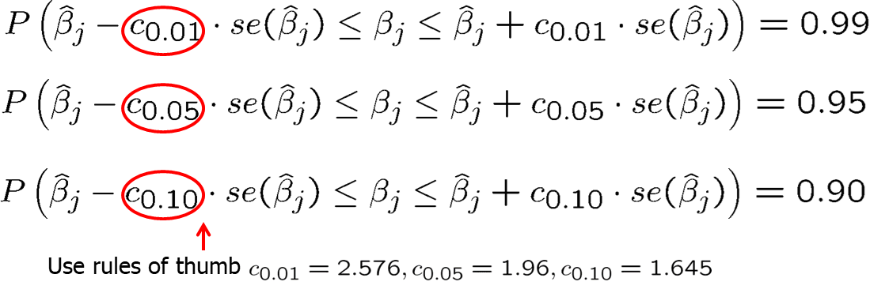
Multiple Regression Analysis: Inference (25 of 37)
Confidence intervals for typical confidence levels
Relationship between confidence intervals and hypotheses tests

Slide 27
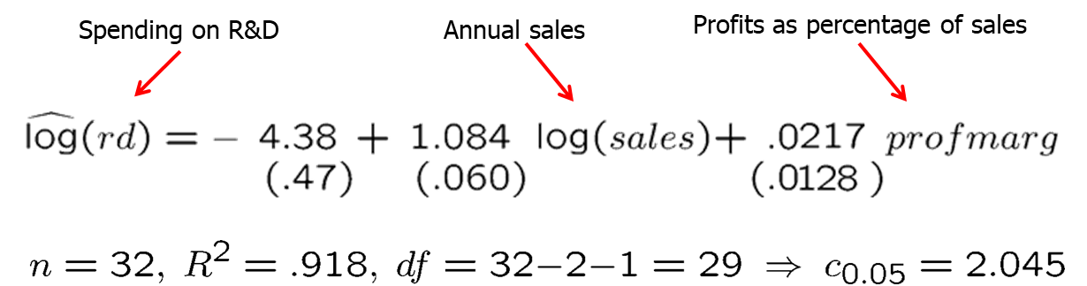
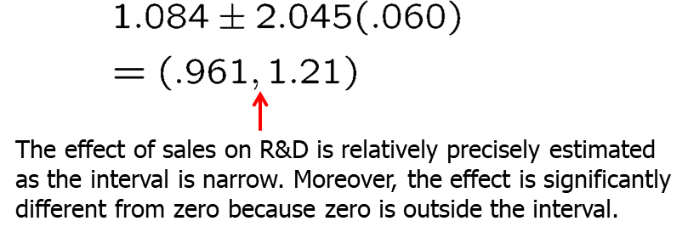
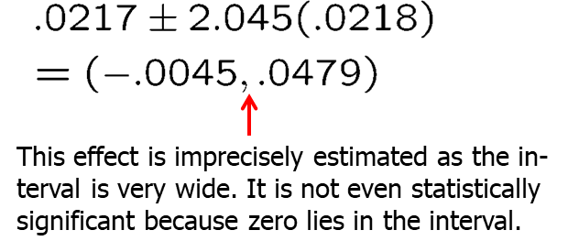
Multiple Regression Analysis: Inference (26 of 37)
Example: Model of firms‘ R&D expenditures

Slide 28
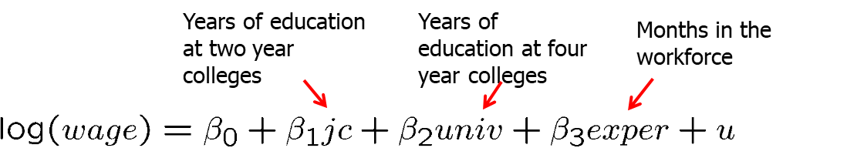
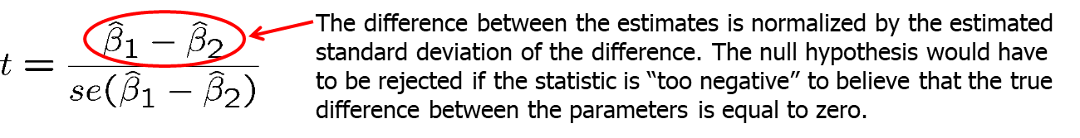
Multiple Regression Analysis: Inference (27 of 37)
Testing hypotheses about a linear combination of the parameters
Example: Return to education at two-year vs. at four-year colleges
A possible test statistic would be:

Slide 29
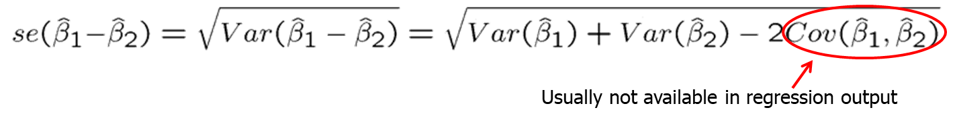
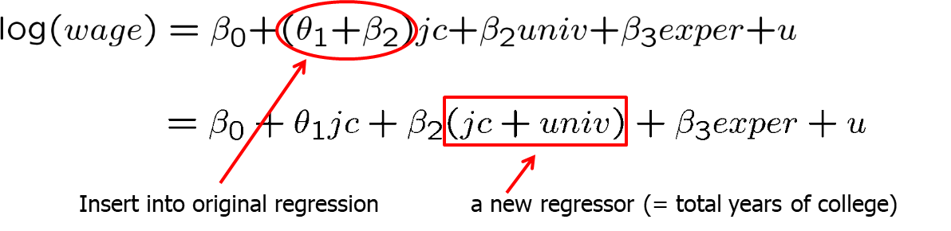
Multiple Regression Analysis: Inference (28 of 37)
The standard error of the difference in parameters is impossible to with standard regression output
An alternative method is to make a substitution in variables.

Slide 30
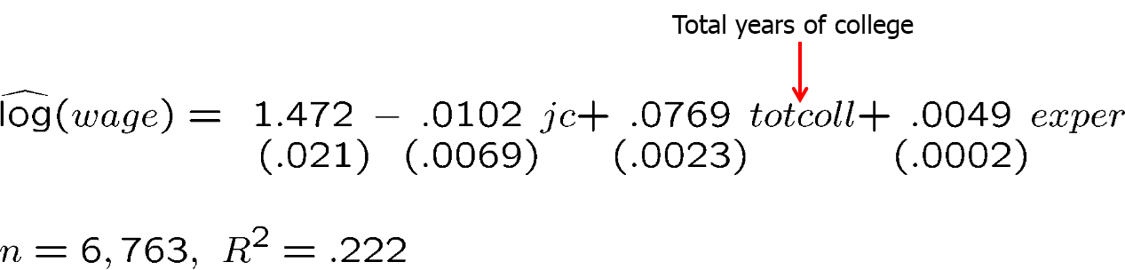
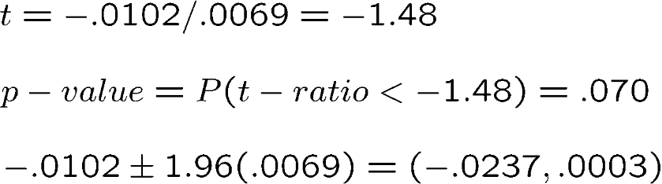
Multiple Regression Analysis: Inference (29 of 37)
Estimation results
This method works always for single linear hypotheses

Slide 31
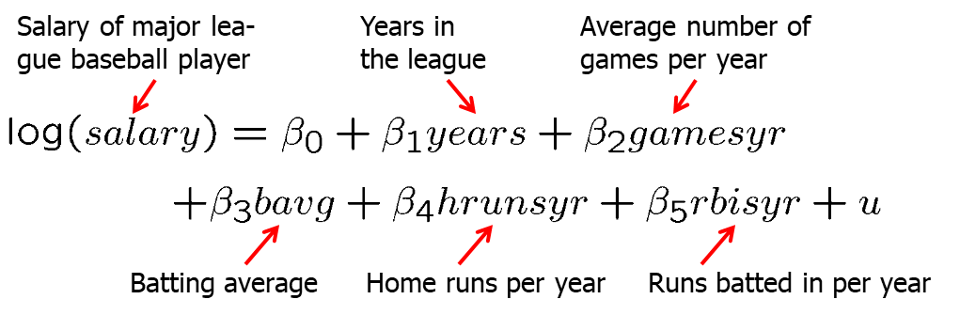
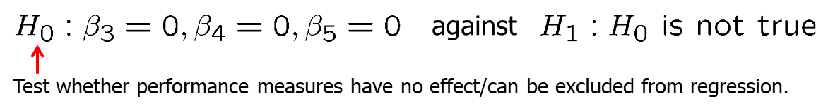
Multiple Regression Analysis: Inference (30 of 37)
Testing multiple linear restrictions: The F-test
Testing exclusion restrictions

Slide 32
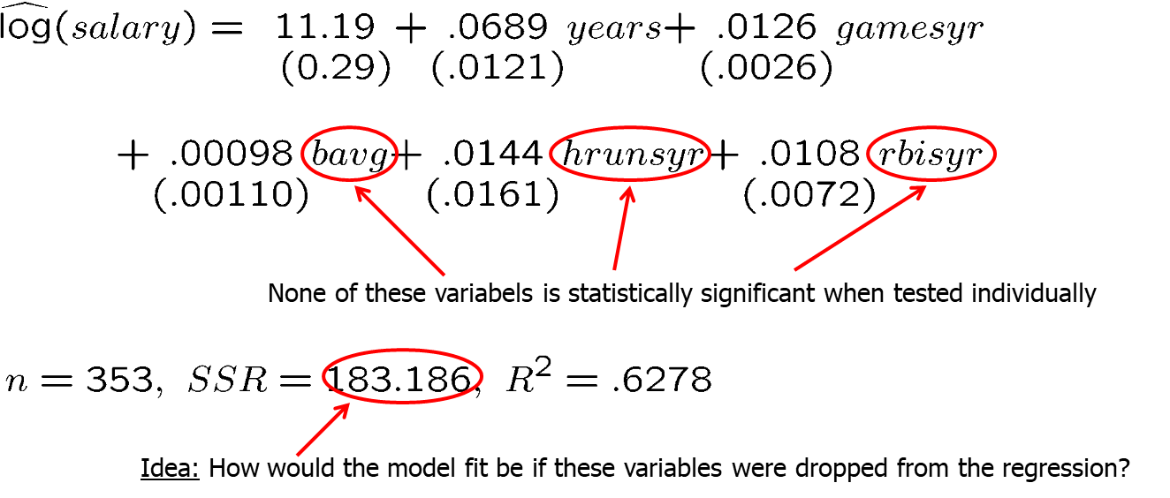
Multiple Regression Analysis: Inference (31 of 37)
Estimation of the unrestricted model

Slide 33
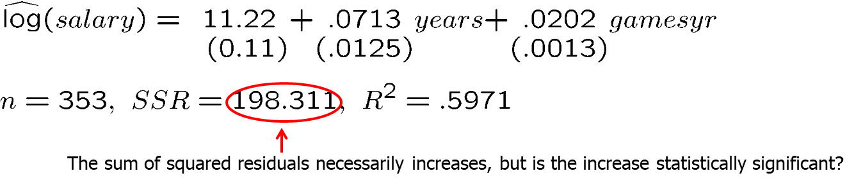
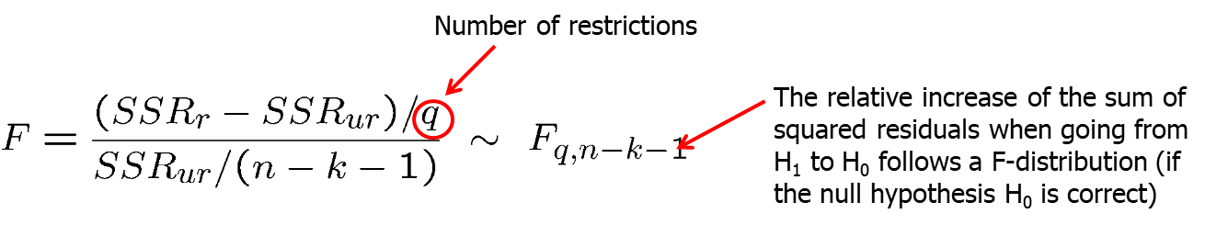
Multiple Regression Analysis: Inference (32 of 37)
Estimation of the restricted model
Test statistic:

Slide 34
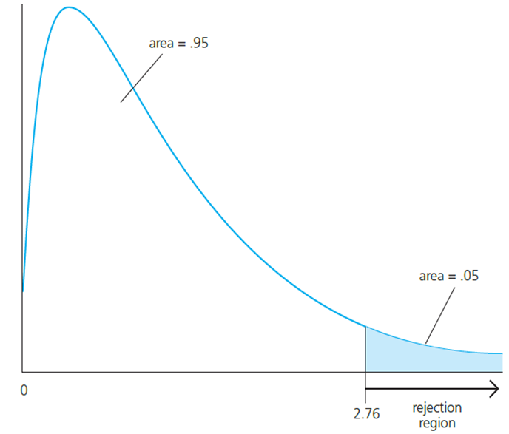
Multiple Regression Analysis: Inference (33 of 37)
Rejection rule
A F-distributed variable only takes on positive values. This corresponds to the fact that the sum of squared residuals can only increase if one moves from H₁ to H₀.
Choose the critical value so that we incorrectly reject the null hypothesis in, for example, only 5% of the cases.

Slide 35
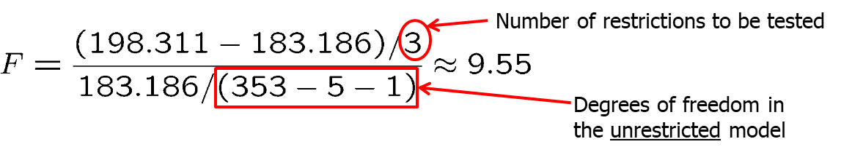
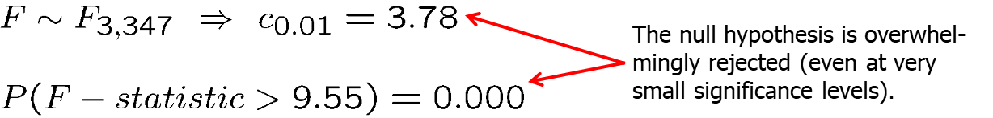
Multiple Regression Analysis: Inference (34 of 37)
Test decision in example
Discussion
The three variables are “jointly significant”
They were not significant when tested individually
The likely reason is multicollinearity between them

Slide 36
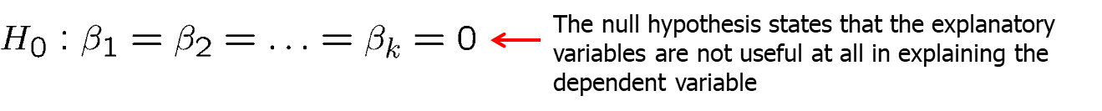

Multiple Regression Analysis: Inference (35 of 37)
Test of overall significance of a regression
Discussion
The three variables are “jointly significant”
They were not significant when tested individually
The likely reason is multicollinearity between them

Slide 37
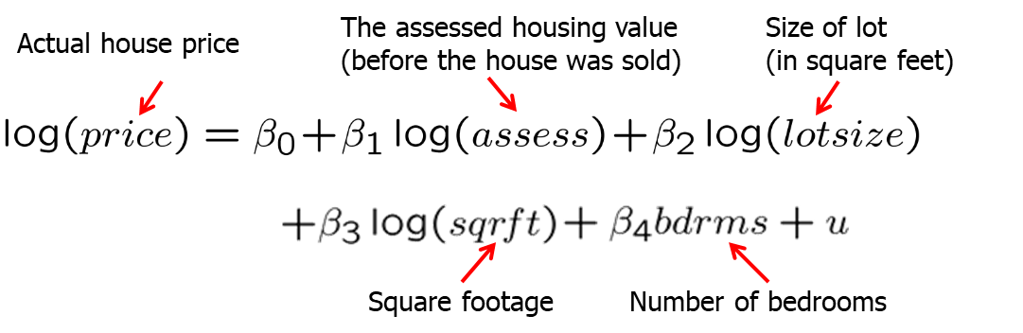

Multiple Regression Analysis: Inference (36 of 37)
Testing general linear restrictions with the F-test
Example: Test whether house price assessments are rational

Slide 38


Multiple Regression Analysis: Inference (37 of 37)
Unrestricted regression
Restricted regression
Test statistic

